Slide 1


SAP BTP Training
Cloud Foundry Training

Slide 2

DISCLAIMER
The training content and delivery of this presentation is confidential, and cannot be recorded, or copied and distributed to any third party, without the written consent of Anubhav Trainings

Slide 3

LEARNING OBJECTIVES
SAP BTP CAPM Development
Introduction to BAS
Generic Handlers
ACID Properties in Database
Fiori Element – introduction
Free style vs Fiori Element
Annotations in CDS
Develop end to end List Report in BAS

Slide 4




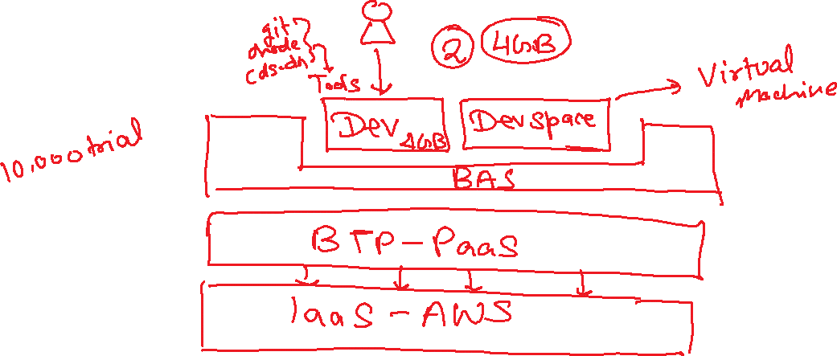
Business Application Studio
SAP Business Application Studio is a development environment available on SAP Business Technology Platform. Before you can start developing using SAP Business Application Studio, administrators must perform the required onboarding steps to create CAPM applications on cloud.
www.anubhavtrainings.com

Slide 5
Generic Handlers
The CAPM Framework generates most of the code for CURDQ operations on the entity, it also does these operations in synchronous manner. At time, we want to
Take full control on CURDQ
I want to add my custom validations before data is updated
We want to change data with enrichment
Read data we want to add extra information
When? (on,before,after) – before
Who? - ENTITY - Employee
Operation? – CREATE, UPDATE
What? – Validate if input Sal < 1mn
DB
User/Developer
Service
CAPM Framework
before
on
after
www.anubhavtrainings.com

Slide 6
ACID properties of DB
A – Atomicity
C - Consistency
I - Isolation
D - Durability
OData V4 which is a latest version of OData version 2. SAP released a backward compatible module which converge the V4 capm services to OData v2.
The module is named as @sap/cds-odata-v2-adapter-proxy
www.anubhavtrainings.com

Slide 7

Summarize
LET’S SUMMARISE!

Slide 8

Summarize
End of Day 13

Slide 10


We’re committed to empower you to be
#FutureReady
through powerful training solutions.
We build the workforce of the future.
250+
Corporate Clients
30,000+
Learners Trained
25000+
Learners Placed
FREE WEBINARS
Sign up for free webinars with industry experts every fortnight!
Enroll Now!
Contact us today!
https://anubhavtrainings.com

